Slide 1
5 Things Food & Beverage Manufacturers Want from Their Honey Supplier

Slide 2
1. The Value Case
Honey has a higher price point than almost all other sweeteners. It’s imperative to prove consumers are willing to pay a higher price point for products with honey.
Consumer surveys
Familiarity
All-natural
Honey bees

Slide 3
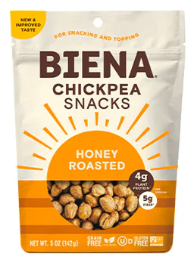
2. New Ideas
59% of food manufacturers agree with the statement: “I like trying/using new or innovative sweeteners.”
The honey industry must position honey as innovative through:
New product ideas
A familiar ingredient with innovative ingredients

Slide 4
3. A Story
Ecommerce has increased competition in all categories, and brands are looking beyond flavor, convenience and nutritional benefits to sell products.
60% of consumers say social media makes them make healthier food choices.*
34% of consumer rank environmental sustainability as a significant purchase driver.*
*2023 Food and Health Survey, International Food Information Council

Slide 5
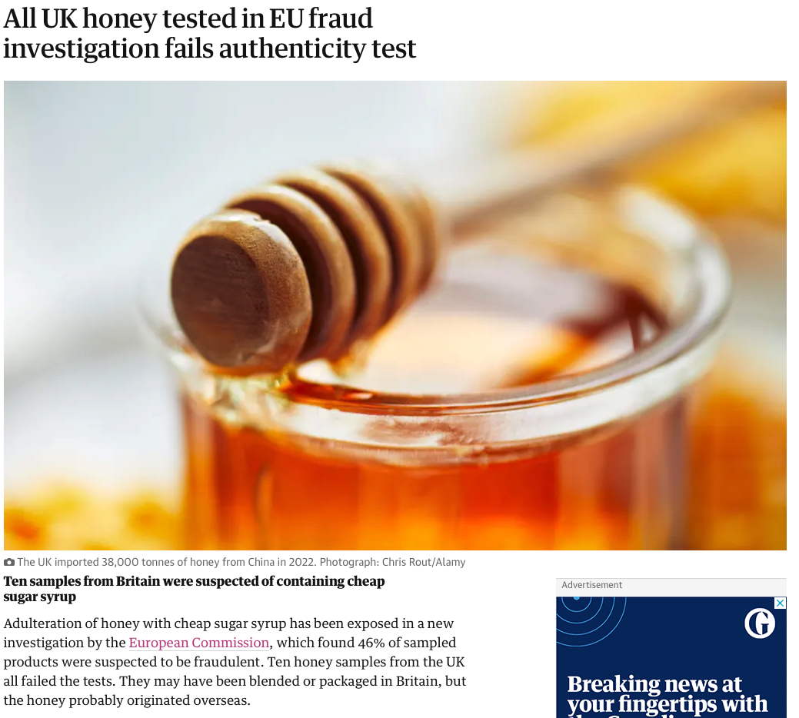
4. Quality Assurance
A combination of synthetic honey public relations and overseas news has cast shadows over the honey industry. Be prepared to talk about:
Food safety practices
Purity of product
Traceability and origin
Testing

Slide 6
5. Supply Stability
38% of food and beverage manufacturers say “Stability of Supply” is the top decision criteria when choosing sweeteners. And, according to these same manufacturers, “Availability” is the main barrier to honey usage.

Slide 7
Email questions to keith@honey.com

