Slide 1
How Flavored Whiskey Drives Honey Sales

Slide 2
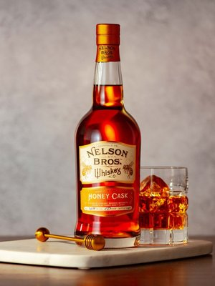
🥃📈 One Big Thing
The alcohol category had the largest increase in new product introductions in 2021. Honey products represented 7% of all new products in the category.
Why it matters: The alcohol category is more recession proof than general food and beverage.

Slide 3
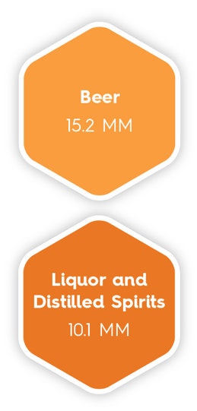
THE NEW NORMAL Once a niche category, now a reliable segment for honey sales.

Slide 4
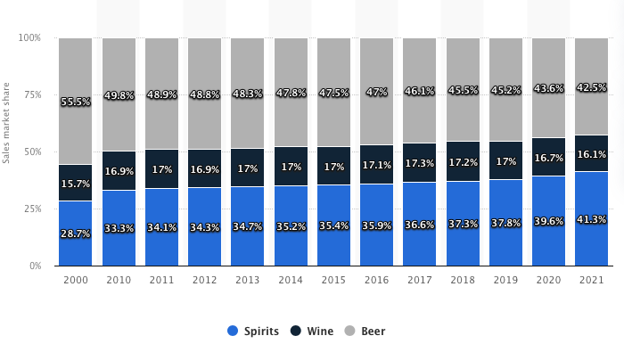

Slide 5
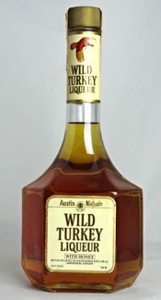
Where it all started
“It’s something we developed for the ladies who thought straight bourbon was a little strong. It was really just our Wild Turkey 101 Bourbon with real honey added to it. Now we call it American Honey, but it’s the same recipe we’ve always used.”
Jimmy Russel, Wild Turkey Founder
1976
2006
Notes:
Our master distillers have stayed true to a tradition from before Prohibition.
Eddie Russell joined Wild Turkey in 1981, and even as the son of Wild Turkey’s famed master distiller, he started as a relief operator and worked his way up. He was inducted into the Bourbon Hall of Fame in 2010. In 2011, he created a new expression of Wild Turkey at 81 proof to be a perfect mixing bourbon: Wild Turkey 81. Most recently, he was promoted to master distiller alongside his dad, making Jimmy and Eddie the only active father and son duo of bourbon master distillers in the world.
READ BIO
Our very own Jimmy Russell is the world’s longest-tenured active master distiller. In 2015 his son, Eddie Russell, was named master distiller in his own right after 35 years with Wild Turkey.
Wild Turkey’s very own Jimmy Russell is the longest-tenured active master distiller in the world. For over 60 years, he’s preserved a tradition that dates back generations. The ultimate craftsman and true ambassador for America’s native spirit, he’s even known as the Buddha of Bourbon by some. His legendary status is no surprise, considering that he’s never wavered on quality. And while he claims he’s just “Plain old Jimmy from Kentucky,” within the community of bourbon makers, he’s often called one more thing: “The Master Distiller’s Master Distiller.”
READ BIOWATCH THE VIDEO
Eddie Russell joined Wild Turkey in 1981, and even as the son of Wild Turkey’s famed master distiller, he started as a relief operator and worked his way up. He was inducted into the Bourbon Hall of Fame in 2010. In 2011, he created a new expression of Wild Turkey at 81 proof to be a perfect mixing bourbon: Wild Turkey 81. Most recently, he was promoted to master distiller alongside his dad, making Jimmy and Eddie the only active father and son duo of bourbon master distillers in the world.
READ BIO
Our very own Jimmy Russell is the world’s longest-tenured active master distiller. In 2015 his son, Eddie Russell, was named master distiller in his own right after 35 years with Wild Turkey.
We never pour a drop of Wild Turkey until it’s aged at least five years – often six or eight or more. Of course, we only have to age it two years to call it a straight bourbon, but we’re not big fans of doing the minimum. Even our tin-clad, wooden rickhouses have stood the test of time; they allow maximum interaction between wood and bourbon, and they’ve been doing it since the 1890s. When we put “Kentucky Straight Bourbon Whiskey” on our label, it’s because our bourbon earned it.
LEARN MORE
Wild Turkey is different for good reason, and it all comes down to premium ingredients, select barrels, and a lot of patience.
LEARN MORE
Your whiskey is only as good as your ingredients. That’s why our water comes from the Kentucky River and is naturally filtered through limestone, removing iron and other impurities. Plus we’re still using our original yeast strain – proprietary to Wild Turkey – which has informed our bourbon’s signature flavor for over 60 years. And you’ll never find a genetically modified grain in our bourbon. Because non-GMO, natural, and authentic is just Jimmy Russell’s way.
LEARN MORE
Not everyone makes a big deal about char – the burn inside American White Oak barrels used to age bourbon. But only a No. 4 “alligator” char, the deepest available, can produce our bourbon’s signature amber color and bold flavor. Others might be content with a No. 1, 2 or 3 char; but it’s something we can never compromise. And, we use No. 4 char across all or our bourbons, giving each one our distinctive and rich flavor.
LEARN MORE
We never pour a drop of Wild Turkey until it’s aged at least five years – often six or eight or more. Of course, we only have to age it two years to call it a straight bourbon, but we’re not big fans of doing the minimum. Even our tin-clad, wooden rickhouses have stood the test of time; they allow maximum interaction between wood and bourbon, and they’ve been doing it since the 1890s. When we put “Kentucky Straight Bourbon Whiskey” on our label, it’s because our bourbon earned it.
LEARN MORE
Wild Turkey is different for good reason, and it all comes down to premium ingredients, select barrels, and a lot of patience.
LEARN MORE
Take a look back through the Wild Turkey Timeline and see how we got to where we are today.
Austin Nichols starts selling wine and spirits as a wholesale grocer. The business he starts would later own Wild Turkey.
The Ripy brothers open their family distillery on Wild Turkey Hill in Lawrenceburg, Kentucky.
The Ripy Brothers’ bourbon represents Kentucky at the World’s Fair in Chicago, Illinois.
Wild Turkey Bourbon gets its name after a distillery executive shares his bourbon with friends on an annual hunting trip — of course, they were after wild turkey.
Master Distiller Jimmy Russell joins Wild Turkey. He’s the third in a line of distillers and learned his craft from Wild Turkey’s second master distiller, Bill Hughes, and Ernest W. Ripy, son of the original distiller.
Wild Turkey introduces the world’s first bourbon liqueur as a way to attract even more people into the bourbon world, which eventually led to the creation of Wild Turkey’s American Honey.
Krupnikas was created in 1593 by Benedictine Monks in the abbey of Niaśviž. It quickly became popular among the Lithuanian and Polish nobility. At the time, the Polish-Lithuanian commonwealth was one of the largest powers in Europe, and despite the Soviet occupation of Lithuania, the drink survived as a traditional stovetop recipe.

Slide 6
The game changer
Jack Daniel’s Tennessee Honey
The first flavored whiskey to sell more than a million cases globally, a feat it accomplished in 2014. Sales have increased every year since and in 2021, 2.2 million cases were sold worldwide.
“Tennessee Honey recruits heavily from the millennial segment. It’s been bringing new consumers into the brand. Around 40% of those that try Honey are trying Jack Daniel’s for the first time, and half of those consumers then come into the franchise.”
John Higgins, VP and marketing director for Jack Daniel’s
2011
Notes:
Our master distillers have stayed true to a tradition from before Prohibition.
Eddie Russell joined Wild Turkey in 1981, and even as the son of Wild Turkey’s famed master distiller, he started as a relief operator and worked his way up. He was inducted into the Bourbon Hall of Fame in 2010. In 2011, he created a new expression of Wild Turkey at 81 proof to be a perfect mixing bourbon: Wild Turkey 81. Most recently, he was promoted to master distiller alongside his dad, making Jimmy and Eddie the only active father and son duo of bourbon master distillers in the world.
READ BIO
Our very own Jimmy Russell is the world’s longest-tenured active master distiller. In 2015 his son, Eddie Russell, was named master distiller in his own right after 35 years with Wild Turkey.
Wild Turkey’s very own Jimmy Russell is the longest-tenured active master distiller in the world. For over 60 years, he’s preserved a tradition that dates back generations. The ultimate craftsman and true ambassador for America’s native spirit, he’s even known as the Buddha of Bourbon by some. His legendary status is no surprise, considering that he’s never wavered on quality. And while he claims he’s just “Plain old Jimmy from Kentucky,” within the community of bourbon makers, he’s often called one more thing: “The Master Distiller’s Master Distiller.”
READ BIOWATCH THE VIDEO
Eddie Russell joined Wild Turkey in 1981, and even as the son of Wild Turkey’s famed master distiller, he started as a relief operator and worked his way up. He was inducted into the Bourbon Hall of Fame in 2010. In 2011, he created a new expression of Wild Turkey at 81 proof to be a perfect mixing bourbon: Wild Turkey 81. Most recently, he was promoted to master distiller alongside his dad, making Jimmy and Eddie the only active father and son duo of bourbon master distillers in the world.
READ BIO
Our very own Jimmy Russell is the world’s longest-tenured active master distiller. In 2015 his son, Eddie Russell, was named master distiller in his own right after 35 years with Wild Turkey.
We never pour a drop of Wild Turkey until it’s aged at least five years – often six or eight or more. Of course, we only have to age it two years to call it a straight bourbon, but we’re not big fans of doing the minimum. Even our tin-clad, wooden rickhouses have stood the test of time; they allow maximum interaction between wood and bourbon, and they’ve been doing it since the 1890s. When we put “Kentucky Straight Bourbon Whiskey” on our label, it’s because our bourbon earned it.
LEARN MORE
Wild Turkey is different for good reason, and it all comes down to premium ingredients, select barrels, and a lot of patience.
LEARN MORE
Your whiskey is only as good as your ingredients. That’s why our water comes from the Kentucky River and is naturally filtered through limestone, removing iron and other impurities. Plus we’re still using our original yeast strain – proprietary to Wild Turkey – which has informed our bourbon’s signature flavor for over 60 years. And you’ll never find a genetically modified grain in our bourbon. Because non-GMO, natural, and authentic is just Jimmy Russell’s way.
LEARN MORE
Not everyone makes a big deal about char – the burn inside American White Oak barrels used to age bourbon. But only a No. 4 “alligator” char, the deepest available, can produce our bourbon’s signature amber color and bold flavor. Others might be content with a No. 1, 2 or 3 char; but it’s something we can never compromise. And, we use No. 4 char across all or our bourbons, giving each one our distinctive and rich flavor.
LEARN MORE
We never pour a drop of Wild Turkey until it’s aged at least five years – often six or eight or more. Of course, we only have to age it two years to call it a straight bourbon, but we’re not big fans of doing the minimum. Even our tin-clad, wooden rickhouses have stood the test of time; they allow maximum interaction between wood and bourbon, and they’ve been doing it since the 1890s. When we put “Kentucky Straight Bourbon Whiskey” on our label, it’s because our bourbon earned it.
LEARN MORE
Wild Turkey is different for good reason, and it all comes down to premium ingredients, select barrels, and a lot of patience.
LEARN MORE
Take a look back through the Wild Turkey Timeline and see how we got to where we are today.
Austin Nichols starts selling wine and spirits as a wholesale grocer. The business he starts would later own Wild Turkey.
The Ripy brothers open their family distillery on Wild Turkey Hill in Lawrenceburg, Kentucky.
The Ripy Brothers’ bourbon represents Kentucky at the World’s Fair in Chicago, Illinois.
Wild Turkey Bourbon gets its name after a distillery executive shares his bourbon with friends on an annual hunting trip — of course, they were after wild turkey.
Master Distiller Jimmy Russell joins Wild Turkey. He’s the third in a line of distillers and learned his craft from Wild Turkey’s second master distiller, Bill Hughes, and Ernest W. Ripy, son of the original distiller.
Wild Turkey introduces the world’s first bourbon liqueur as a way to attract even more people into the bourbon world, which eventually led to the creation of Wild Turkey’s American Honey.
Krupnikas was created in 1593 by Benedictine Monks in the abbey of Niaśviž. It quickly became popular among the Lithuanian and Polish nobility. At the time, the Polish-Lithuanian commonwealth was one of the largest powers in Europe, and despite the Soviet occupation of Lithuania, the drink survived as a traditional stovetop recipe.

Slide 7
I’m not a math major, but….
1 Bottle of Tennessee Honey is 25.36 ounces
At 6% honey (I’m guessing!), there are 1.5216 ounces of honey per bottle of Tennessee Honey.
2.2 million cases of Tennessee Honey were sold last year.
That’s 26,400,000 bottles of honey whiskey.
That’s 2,510,640 lbs. of honey a year for one whiskey!
Notes:
Our master distillers have stayed true to a tradition from before Prohibition.
Eddie Russell joined Wild Turkey in 1981, and even as the son of Wild Turkey’s famed master distiller, he started as a relief operator and worked his way up. He was inducted into the Bourbon Hall of Fame in 2010. In 2011, he created a new expression of Wild Turkey at 81 proof to be a perfect mixing bourbon: Wild Turkey 81. Most recently, he was promoted to master distiller alongside his dad, making Jimmy and Eddie the only active father and son duo of bourbon master distillers in the world.
READ BIO
Our very own Jimmy Russell is the world’s longest-tenured active master distiller. In 2015 his son, Eddie Russell, was named master distiller in his own right after 35 years with Wild Turkey.
Wild Turkey’s very own Jimmy Russell is the longest-tenured active master distiller in the world. For over 60 years, he’s preserved a tradition that dates back generations. The ultimate craftsman and true ambassador for America’s native spirit, he’s even known as the Buddha of Bourbon by some. His legendary status is no surprise, considering that he’s never wavered on quality. And while he claims he’s just “Plain old Jimmy from Kentucky,” within the community of bourbon makers, he’s often called one more thing: “The Master Distiller’s Master Distiller.”
READ BIOWATCH THE VIDEO
Eddie Russell joined Wild Turkey in 1981, and even as the son of Wild Turkey’s famed master distiller, he started as a relief operator and worked his way up. He was inducted into the Bourbon Hall of Fame in 2010. In 2011, he created a new expression of Wild Turkey at 81 proof to be a perfect mixing bourbon: Wild Turkey 81. Most recently, he was promoted to master distiller alongside his dad, making Jimmy and Eddie the only active father and son duo of bourbon master distillers in the world.
READ BIO
Our very own Jimmy Russell is the world’s longest-tenured active master distiller. In 2015 his son, Eddie Russell, was named master distiller in his own right after 35 years with Wild Turkey.
We never pour a drop of Wild Turkey until it’s aged at least five years – often six or eight or more. Of course, we only have to age it two years to call it a straight bourbon, but we’re not big fans of doing the minimum. Even our tin-clad, wooden rickhouses have stood the test of time; they allow maximum interaction between wood and bourbon, and they’ve been doing it since the 1890s. When we put “Kentucky Straight Bourbon Whiskey” on our label, it’s because our bourbon earned it.
LEARN MORE
Wild Turkey is different for good reason, and it all comes down to premium ingredients, select barrels, and a lot of patience.
LEARN MORE
Your whiskey is only as good as your ingredients. That’s why our water comes from the Kentucky River and is naturally filtered through limestone, removing iron and other impurities. Plus we’re still using our original yeast strain – proprietary to Wild Turkey – which has informed our bourbon’s signature flavor for over 60 years. And you’ll never find a genetically modified grain in our bourbon. Because non-GMO, natural, and authentic is just Jimmy Russell’s way.
LEARN MORE
Not everyone makes a big deal about char – the burn inside American White Oak barrels used to age bourbon. But only a No. 4 “alligator” char, the deepest available, can produce our bourbon’s signature amber color and bold flavor. Others might be content with a No. 1, 2 or 3 char; but it’s something we can never compromise. And, we use No. 4 char across all or our bourbons, giving each one our distinctive and rich flavor.
LEARN MORE
We never pour a drop of Wild Turkey until it’s aged at least five years – often six or eight or more. Of course, we only have to age it two years to call it a straight bourbon, but we’re not big fans of doing the minimum. Even our tin-clad, wooden rickhouses have stood the test of time; they allow maximum interaction between wood and bourbon, and they’ve been doing it since the 1890s. When we put “Kentucky Straight Bourbon Whiskey” on our label, it’s because our bourbon earned it.
LEARN MORE
Wild Turkey is different for good reason, and it all comes down to premium ingredients, select barrels, and a lot of patience.
LEARN MORE
Take a look back through the Wild Turkey Timeline and see how we got to where we are today.
Austin Nichols starts selling wine and spirits as a wholesale grocer. The business he starts would later own Wild Turkey.
The Ripy brothers open their family distillery on Wild Turkey Hill in Lawrenceburg, Kentucky.
The Ripy Brothers’ bourbon represents Kentucky at the World’s Fair in Chicago, Illinois.
Wild Turkey Bourbon gets its name after a distillery executive shares his bourbon with friends on an annual hunting trip — of course, they were after wild turkey.
Master Distiller Jimmy Russell joins Wild Turkey. He’s the third in a line of distillers and learned his craft from Wild Turkey’s second master distiller, Bill Hughes, and Ernest W. Ripy, son of the original distiller.
Wild Turkey introduces the world’s first bourbon liqueur as a way to attract even more people into the bourbon world, which eventually led to the creation of Wild Turkey’s American Honey.
Krupnikas was created in 1593 by Benedictine Monks in the abbey of Niaśviž. It quickly became popular among the Lithuanian and Polish nobility. At the time, the Polish-Lithuanian commonwealth was one of the largest powers in Europe, and despite the Soviet occupation of Lithuania, the drink survived as a traditional stovetop recipe.

Slide 8
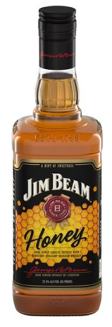
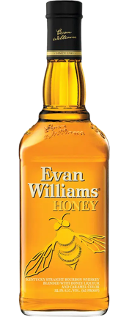
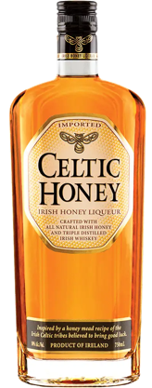
Notes:
Our master distillers have stayed true to a tradition from before Prohibition.
Eddie Russell joined Wild Turkey in 1981, and even as the son of Wild Turkey’s famed master distiller, he started as a relief operator and worked his way up. He was inducted into the Bourbon Hall of Fame in 2010. In 2011, he created a new expression of Wild Turkey at 81 proof to be a perfect mixing bourbon: Wild Turkey 81. Most recently, he was promoted to master distiller alongside his dad, making Jimmy and Eddie the only active father and son duo of bourbon master distillers in the world.
READ BIO
Our very own Jimmy Russell is the world’s longest-tenured active master distiller. In 2015 his son, Eddie Russell, was named master distiller in his own right after 35 years with Wild Turkey.
Wild Turkey’s very own Jimmy Russell is the longest-tenured active master distiller in the world. For over 60 years, he’s preserved a tradition that dates back generations. The ultimate craftsman and true ambassador for America’s native spirit, he’s even known as the Buddha of Bourbon by some. His legendary status is no surprise, considering that he’s never wavered on quality. And while he claims he’s just “Plain old Jimmy from Kentucky,” within the community of bourbon makers, he’s often called one more thing: “The Master Distiller’s Master Distiller.”
READ BIOWATCH THE VIDEO
Eddie Russell joined Wild Turkey in 1981, and even as the son of Wild Turkey’s famed master distiller, he started as a relief operator and worked his way up. He was inducted into the Bourbon Hall of Fame in 2010. In 2011, he created a new expression of Wild Turkey at 81 proof to be a perfect mixing bourbon: Wild Turkey 81. Most recently, he was promoted to master distiller alongside his dad, making Jimmy and Eddie the only active father and son duo of bourbon master distillers in the world.
READ BIO
Our very own Jimmy Russell is the world’s longest-tenured active master distiller. In 2015 his son, Eddie Russell, was named master distiller in his own right after 35 years with Wild Turkey.
We never pour a drop of Wild Turkey until it’s aged at least five years – often six or eight or more. Of course, we only have to age it two years to call it a straight bourbon, but we’re not big fans of doing the minimum. Even our tin-clad, wooden rickhouses have stood the test of time; they allow maximum interaction between wood and bourbon, and they’ve been doing it since the 1890s. When we put “Kentucky Straight Bourbon Whiskey” on our label, it’s because our bourbon earned it.
LEARN MORE
Wild Turkey is different for good reason, and it all comes down to premium ingredients, select barrels, and a lot of patience.
LEARN MORE
Your whiskey is only as good as your ingredients. That’s why our water comes from the Kentucky River and is naturally filtered through limestone, removing iron and other impurities. Plus we’re still using our original yeast strain – proprietary to Wild Turkey – which has informed our bourbon’s signature flavor for over 60 years. And you’ll never find a genetically modified grain in our bourbon. Because non-GMO, natural, and authentic is just Jimmy Russell’s way.
LEARN MORE
Not everyone makes a big deal about char – the burn inside American White Oak barrels used to age bourbon. But only a No. 4 “alligator” char, the deepest available, can produce our bourbon’s signature amber color and bold flavor. Others might be content with a No. 1, 2 or 3 char; but it’s something we can never compromise. And, we use No. 4 char across all or our bourbons, giving each one our distinctive and rich flavor.
LEARN MORE
We never pour a drop of Wild Turkey until it’s aged at least five years – often six or eight or more. Of course, we only have to age it two years to call it a straight bourbon, but we’re not big fans of doing the minimum. Even our tin-clad, wooden rickhouses have stood the test of time; they allow maximum interaction between wood and bourbon, and they’ve been doing it since the 1890s. When we put “Kentucky Straight Bourbon Whiskey” on our label, it’s because our bourbon earned it.
LEARN MORE
Wild Turkey is different for good reason, and it all comes down to premium ingredients, select barrels, and a lot of patience.
LEARN MORE
Take a look back through the Wild Turkey Timeline and see how we got to where we are today.
Austin Nichols starts selling wine and spirits as a wholesale grocer. The business he starts would later own Wild Turkey.
The Ripy brothers open their family distillery on Wild Turkey Hill in Lawrenceburg, Kentucky.
The Ripy Brothers’ bourbon represents Kentucky at the World’s Fair in Chicago, Illinois.
Wild Turkey Bourbon gets its name after a distillery executive shares his bourbon with friends on an annual hunting trip — of course, they were after wild turkey.
Master Distiller Jimmy Russell joins Wild Turkey. He’s the third in a line of distillers and learned his craft from Wild Turkey’s second master distiller, Bill Hughes, and Ernest W. Ripy, son of the original distiller.
Wild Turkey introduces the world’s first bourbon liqueur as a way to attract even more people into the bourbon world, which eventually led to the creation of Wild Turkey’s American Honey.
Krupnikas was created in 1593 by Benedictine Monks in the abbey of Niaśviž. It quickly became popular among the Lithuanian and Polish nobility. At the time, the Polish-Lithuanian commonwealth was one of the largest powers in Europe, and despite the Soviet occupation of Lithuania, the drink survived as a traditional stovetop recipe.

Slide 9
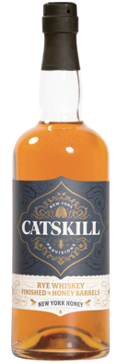
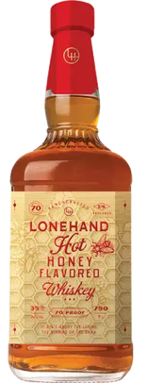
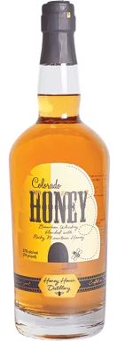
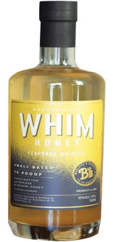
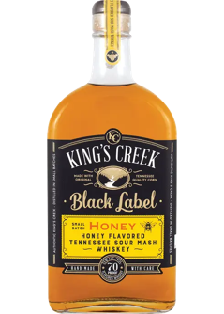
Notes:
Our master distillers have stayed true to a tradition from before Prohibition.
Eddie Russell joined Wild Turkey in 1981, and even as the son of Wild Turkey’s famed master distiller, he started as a relief operator and worked his way up. He was inducted into the Bourbon Hall of Fame in 2010. In 2011, he created a new expression of Wild Turkey at 81 proof to be a perfect mixing bourbon: Wild Turkey 81. Most recently, he was promoted to master distiller alongside his dad, making Jimmy and Eddie the only active father and son duo of bourbon master distillers in the world.
READ BIO
Our very own Jimmy Russell is the world’s longest-tenured active master distiller. In 2015 his son, Eddie Russell, was named master distiller in his own right after 35 years with Wild Turkey.
Wild Turkey’s very own Jimmy Russell is the longest-tenured active master distiller in the world. For over 60 years, he’s preserved a tradition that dates back generations. The ultimate craftsman and true ambassador for America’s native spirit, he’s even known as the Buddha of Bourbon by some. His legendary status is no surprise, considering that he’s never wavered on quality. And while he claims he’s just “Plain old Jimmy from Kentucky,” within the community of bourbon makers, he’s often called one more thing: “The Master Distiller’s Master Distiller.”
READ BIOWATCH THE VIDEO
Eddie Russell joined Wild Turkey in 1981, and even as the son of Wild Turkey’s famed master distiller, he started as a relief operator and worked his way up. He was inducted into the Bourbon Hall of Fame in 2010. In 2011, he created a new expression of Wild Turkey at 81 proof to be a perfect mixing bourbon: Wild Turkey 81. Most recently, he was promoted to master distiller alongside his dad, making Jimmy and Eddie the only active father and son duo of bourbon master distillers in the world.
READ BIO
Our very own Jimmy Russell is the world’s longest-tenured active master distiller. In 2015 his son, Eddie Russell, was named master distiller in his own right after 35 years with Wild Turkey.
We never pour a drop of Wild Turkey until it’s aged at least five years – often six or eight or more. Of course, we only have to age it two years to call it a straight bourbon, but we’re not big fans of doing the minimum. Even our tin-clad, wooden rickhouses have stood the test of time; they allow maximum interaction between wood and bourbon, and they’ve been doing it since the 1890s. When we put “Kentucky Straight Bourbon Whiskey” on our label, it’s because our bourbon earned it.
LEARN MORE
Wild Turkey is different for good reason, and it all comes down to premium ingredients, select barrels, and a lot of patience.
LEARN MORE
Your whiskey is only as good as your ingredients. That’s why our water comes from the Kentucky River and is naturally filtered through limestone, removing iron and other impurities. Plus we’re still using our original yeast strain – proprietary to Wild Turkey – which has informed our bourbon’s signature flavor for over 60 years. And you’ll never find a genetically modified grain in our bourbon. Because non-GMO, natural, and authentic is just Jimmy Russell’s way.
LEARN MORE
Not everyone makes a big deal about char – the burn inside American White Oak barrels used to age bourbon. But only a No. 4 “alligator” char, the deepest available, can produce our bourbon’s signature amber color and bold flavor. Others might be content with a No. 1, 2 or 3 char; but it’s something we can never compromise. And, we use No. 4 char across all or our bourbons, giving each one our distinctive and rich flavor.
LEARN MORE
We never pour a drop of Wild Turkey until it’s aged at least five years – often six or eight or more. Of course, we only have to age it two years to call it a straight bourbon, but we’re not big fans of doing the minimum. Even our tin-clad, wooden rickhouses have stood the test of time; they allow maximum interaction between wood and bourbon, and they’ve been doing it since the 1890s. When we put “Kentucky Straight Bourbon Whiskey” on our label, it’s because our bourbon earned it.
LEARN MORE
Wild Turkey is different for good reason, and it all comes down to premium ingredients, select barrels, and a lot of patience.
LEARN MORE
Take a look back through the Wild Turkey Timeline and see how we got to where we are today.
Austin Nichols starts selling wine and spirits as a wholesale grocer. The business he starts would later own Wild Turkey.
The Ripy brothers open their family distillery on Wild Turkey Hill in Lawrenceburg, Kentucky.
The Ripy Brothers’ bourbon represents Kentucky at the World’s Fair in Chicago, Illinois.
Wild Turkey Bourbon gets its name after a distillery executive shares his bourbon with friends on an annual hunting trip — of course, they were after wild turkey.
Master Distiller Jimmy Russell joins Wild Turkey. He’s the third in a line of distillers and learned his craft from Wild Turkey’s second master distiller, Bill Hughes, and Ernest W. Ripy, son of the original distiller.
Wild Turkey introduces the world’s first bourbon liqueur as a way to attract even more people into the bourbon world, which eventually led to the creation of Wild Turkey’s American Honey.
Krupnikas was created in 1593 by Benedictine Monks in the abbey of Niaśviž. It quickly became popular among the Lithuanian and Polish nobility. At the time, the Polish-Lithuanian commonwealth was one of the largest powers in Europe, and despite the Soviet occupation of Lithuania, the drink survived as a traditional stovetop recipe.

Slide 10
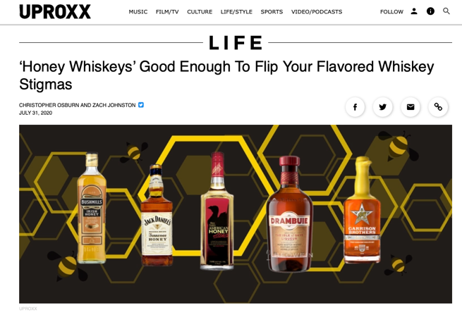

Slide 11
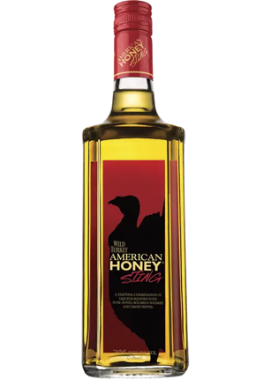
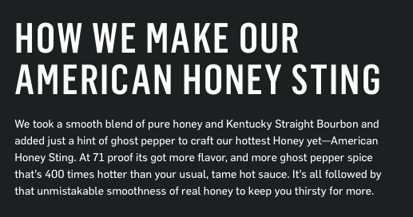
Notes:
Our master distillers have stayed true to a tradition from before Prohibition.
Eddie Russell joined Wild Turkey in 1981, and even as the son of Wild Turkey’s famed master distiller, he started as a relief operator and worked his way up. He was inducted into the Bourbon Hall of Fame in 2010. In 2011, he created a new expression of Wild Turkey at 81 proof to be a perfect mixing bourbon: Wild Turkey 81. Most recently, he was promoted to master distiller alongside his dad, making Jimmy and Eddie the only active father and son duo of bourbon master distillers in the world.
READ BIO
Our very own Jimmy Russell is the world’s longest-tenured active master distiller. In 2015 his son, Eddie Russell, was named master distiller in his own right after 35 years with Wild Turkey.
Wild Turkey’s very own Jimmy Russell is the longest-tenured active master distiller in the world. For over 60 years, he’s preserved a tradition that dates back generations. The ultimate craftsman and true ambassador for America’s native spirit, he’s even known as the Buddha of Bourbon by some. His legendary status is no surprise, considering that he’s never wavered on quality. And while he claims he’s just “Plain old Jimmy from Kentucky,” within the community of bourbon makers, he’s often called one more thing: “The Master Distiller’s Master Distiller.”
READ BIOWATCH THE VIDEO
Eddie Russell joined Wild Turkey in 1981, and even as the son of Wild Turkey’s famed master distiller, he started as a relief operator and worked his way up. He was inducted into the Bourbon Hall of Fame in 2010. In 2011, he created a new expression of Wild Turkey at 81 proof to be a perfect mixing bourbon: Wild Turkey 81. Most recently, he was promoted to master distiller alongside his dad, making Jimmy and Eddie the only active father and son duo of bourbon master distillers in the world.
READ BIO
Our very own Jimmy Russell is the world’s longest-tenured active master distiller. In 2015 his son, Eddie Russell, was named master distiller in his own right after 35 years with Wild Turkey.
We never pour a drop of Wild Turkey until it’s aged at least five years – often six or eight or more. Of course, we only have to age it two years to call it a straight bourbon, but we’re not big fans of doing the minimum. Even our tin-clad, wooden rickhouses have stood the test of time; they allow maximum interaction between wood and bourbon, and they’ve been doing it since the 1890s. When we put “Kentucky Straight Bourbon Whiskey” on our label, it’s because our bourbon earned it.
LEARN MORE
Wild Turkey is different for good reason, and it all comes down to premium ingredients, select barrels, and a lot of patience.
LEARN MORE
Your whiskey is only as good as your ingredients. That’s why our water comes from the Kentucky River and is naturally filtered through limestone, removing iron and other impurities. Plus we’re still using our original yeast strain – proprietary to Wild Turkey – which has informed our bourbon’s signature flavor for over 60 years. And you’ll never find a genetically modified grain in our bourbon. Because non-GMO, natural, and authentic is just Jimmy Russell’s way.
LEARN MORE
Not everyone makes a big deal about char – the burn inside American White Oak barrels used to age bourbon. But only a No. 4 “alligator” char, the deepest available, can produce our bourbon’s signature amber color and bold flavor. Others might be content with a No. 1, 2 or 3 char; but it’s something we can never compromise. And, we use No. 4 char across all or our bourbons, giving each one our distinctive and rich flavor.
LEARN MORE
We never pour a drop of Wild Turkey until it’s aged at least five years – often six or eight or more. Of course, we only have to age it two years to call it a straight bourbon, but we’re not big fans of doing the minimum. Even our tin-clad, wooden rickhouses have stood the test of time; they allow maximum interaction between wood and bourbon, and they’ve been doing it since the 1890s. When we put “Kentucky Straight Bourbon Whiskey” on our label, it’s because our bourbon earned it.
LEARN MORE
Wild Turkey is different for good reason, and it all comes down to premium ingredients, select barrels, and a lot of patience.
LEARN MORE
Take a look back through the Wild Turkey Timeline and see how we got to where we are today.
Austin Nichols starts selling wine and spirits as a wholesale grocer. The business he starts would later own Wild Turkey.
The Ripy brothers open their family distillery on Wild Turkey Hill in Lawrenceburg, Kentucky.
The Ripy Brothers’ bourbon represents Kentucky at the World’s Fair in Chicago, Illinois.
Wild Turkey Bourbon gets its name after a distillery executive shares his bourbon with friends on an annual hunting trip — of course, they were after wild turkey.
Master Distiller Jimmy Russell joins Wild Turkey. He’s the third in a line of distillers and learned his craft from Wild Turkey’s second master distiller, Bill Hughes, and Ernest W. Ripy, son of the original distiller.
Wild Turkey introduces the world’s first bourbon liqueur as a way to attract even more people into the bourbon world, which eventually led to the creation of Wild Turkey’s American Honey.
Krupnikas was created in 1593 by Benedictine Monks in the abbey of Niaśviž. It quickly became popular among the Lithuanian and Polish nobility. At the time, the Polish-Lithuanian commonwealth was one of the largest powers in Europe, and despite the Soviet occupation of Lithuania, the drink survived as a traditional stovetop recipe.

Slide 12
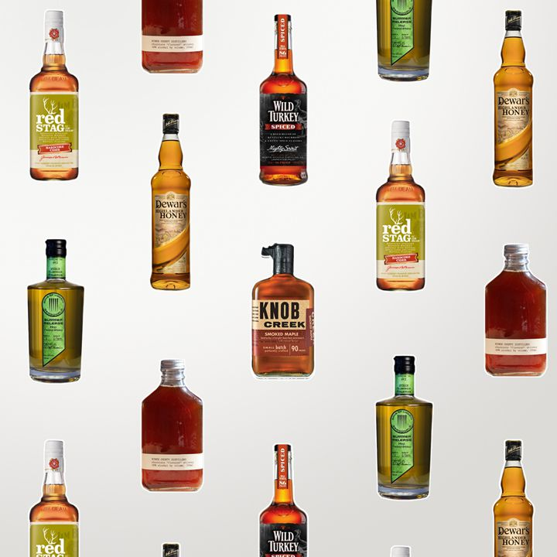
🔥🔥🔥🔥
Flavored Whiskey
$27 billion in 2022
$55 billion by 2032

Slide 13
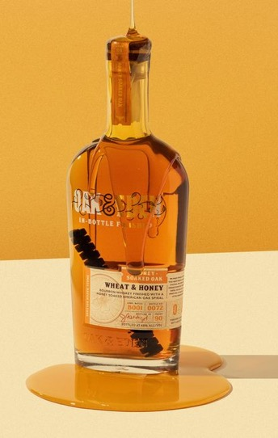
Methods for Using Honey in Whiskey
Blend / back sweeten
Honey cask
Stave infusion in tank
Make mead with whiskey yeast
Oak & Eden Wheat & Honey Whiskey
Wheated bourbon with a honey-infused oak spire added to bottle.
Notes:
Our master distillers have stayed true to a tradition from before Prohibition.
Eddie Russell joined Wild Turkey in 1981, and even as the son of Wild Turkey’s famed master distiller, he started as a relief operator and worked his way up. He was inducted into the Bourbon Hall of Fame in 2010. In 2011, he created a new expression of Wild Turkey at 81 proof to be a perfect mixing bourbon: Wild Turkey 81. Most recently, he was promoted to master distiller alongside his dad, making Jimmy and Eddie the only active father and son duo of bourbon master distillers in the world.
READ BIO
Our very own Jimmy Russell is the world’s longest-tenured active master distiller. In 2015 his son, Eddie Russell, was named master distiller in his own right after 35 years with Wild Turkey.
Wild Turkey’s very own Jimmy Russell is the longest-tenured active master distiller in the world. For over 60 years, he’s preserved a tradition that dates back generations. The ultimate craftsman and true ambassador for America’s native spirit, he’s even known as the Buddha of Bourbon by some. His legendary status is no surprise, considering that he’s never wavered on quality. And while he claims he’s just “Plain old Jimmy from Kentucky,” within the community of bourbon makers, he’s often called one more thing: “The Master Distiller’s Master Distiller.”
READ BIOWATCH THE VIDEO
Eddie Russell joined Wild Turkey in 1981, and even as the son of Wild Turkey’s famed master distiller, he started as a relief operator and worked his way up. He was inducted into the Bourbon Hall of Fame in 2010. In 2011, he created a new expression of Wild Turkey at 81 proof to be a perfect mixing bourbon: Wild Turkey 81. Most recently, he was promoted to master distiller alongside his dad, making Jimmy and Eddie the only active father and son duo of bourbon master distillers in the world.
READ BIO
Our very own Jimmy Russell is the world’s longest-tenured active master distiller. In 2015 his son, Eddie Russell, was named master distiller in his own right after 35 years with Wild Turkey.
We never pour a drop of Wild Turkey until it’s aged at least five years – often six or eight or more. Of course, we only have to age it two years to call it a straight bourbon, but we’re not big fans of doing the minimum. Even our tin-clad, wooden rickhouses have stood the test of time; they allow maximum interaction between wood and bourbon, and they’ve been doing it since the 1890s. When we put “Kentucky Straight Bourbon Whiskey” on our label, it’s because our bourbon earned it.
LEARN MORE
Wild Turkey is different for good reason, and it all comes down to premium ingredients, select barrels, and a lot of patience.
LEARN MORE
Your whiskey is only as good as your ingredients. That’s why our water comes from the Kentucky River and is naturally filtered through limestone, removing iron and other impurities. Plus we’re still using our original yeast strain – proprietary to Wild Turkey – which has informed our bourbon’s signature flavor for over 60 years. And you’ll never find a genetically modified grain in our bourbon. Because non-GMO, natural, and authentic is just Jimmy Russell’s way.
LEARN MORE
Not everyone makes a big deal about char – the burn inside American White Oak barrels used to age bourbon. But only a No. 4 “alligator” char, the deepest available, can produce our bourbon’s signature amber color and bold flavor. Others might be content with a No. 1, 2 or 3 char; but it’s something we can never compromise. And, we use No. 4 char across all or our bourbons, giving each one our distinctive and rich flavor.
LEARN MORE
We never pour a drop of Wild Turkey until it’s aged at least five years – often six or eight or more. Of course, we only have to age it two years to call it a straight bourbon, but we’re not big fans of doing the minimum. Even our tin-clad, wooden rickhouses have stood the test of time; they allow maximum interaction between wood and bourbon, and they’ve been doing it since the 1890s. When we put “Kentucky Straight Bourbon Whiskey” on our label, it’s because our bourbon earned it.
LEARN MORE
Wild Turkey is different for good reason, and it all comes down to premium ingredients, select barrels, and a lot of patience.
LEARN MORE
Take a look back through the Wild Turkey Timeline and see how we got to where we are today.
Austin Nichols starts selling wine and spirits as a wholesale grocer. The business he starts would later own Wild Turkey.
The Ripy brothers open their family distillery on Wild Turkey Hill in Lawrenceburg, Kentucky.
The Ripy Brothers’ bourbon represents Kentucky at the World’s Fair in Chicago, Illinois.
Wild Turkey Bourbon gets its name after a distillery executive shares his bourbon with friends on an annual hunting trip — of course, they were after wild turkey.
Master Distiller Jimmy Russell joins Wild Turkey. He’s the third in a line of distillers and learned his craft from Wild Turkey’s second master distiller, Bill Hughes, and Ernest W. Ripy, son of the original distiller.
Wild Turkey introduces the world’s first bourbon liqueur as a way to attract even more people into the bourbon world, which eventually led to the creation of Wild Turkey’s American Honey.
Krupnikas was created in 1593 by Benedictine Monks in the abbey of Niaśviž. It quickly became popular among the Lithuanian and Polish nobility. At the time, the Polish-Lithuanian commonwealth was one of the largest powers in Europe, and despite the Soviet occupation of Lithuania, the drink survived as a traditional stovetop recipe.

Slide 14
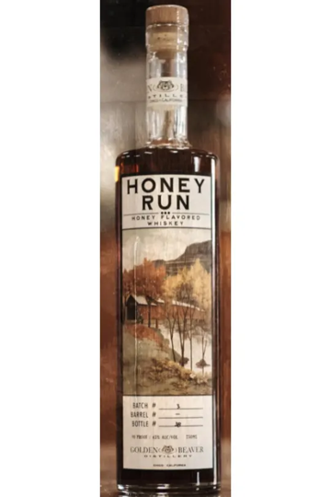
Golden Beaver Distillery
Honey Run
Proof: 80
Process: This American craft whiskey starts as a straight bourbon with a 21% rye mash bill. Northern California Wildflower honey is blended in to give a hint of sweetness.
Gold Medal winner at Honey Spirits Competition.

Slide 15
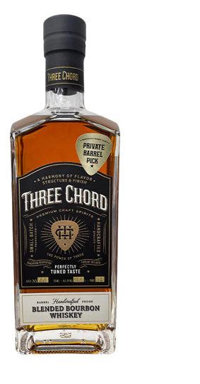
Three Chord
Honey Cask Finish
Proof: 117
Process: 50% Blend of distillery’s base whiskey with a honey cask finish.
Spirit ”proofed up” to balance the sweetness from the honey.

Slide 16
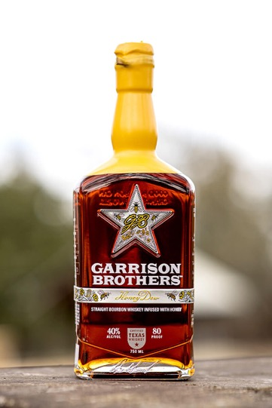
Garrison Brothers
Honey Dew
Proof: 80
Process: Used bourbon barrels are cut into small, wooden cubes that are then immersed in honey.
After fully absorbing the honey, the cubes are placed in the belly of a stainless-steel tank, letting the bourbon soak up the honey flavors for seven months.

Slide 17
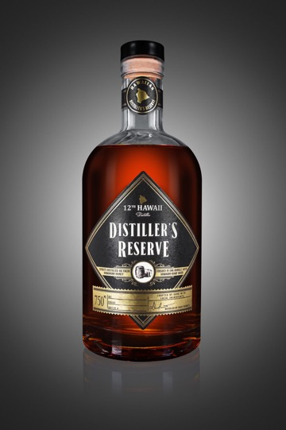
12th Hawaii Distillery
Distiller’s Reserve
Proof: 90
Process: Use whiskey yeast to ferment mead. Distilled 4x and aged in a charred oak barrel.
Best of Show at Honey Spirits Competition.

Slide 18
What’s Trending in Spirits

Slide 19
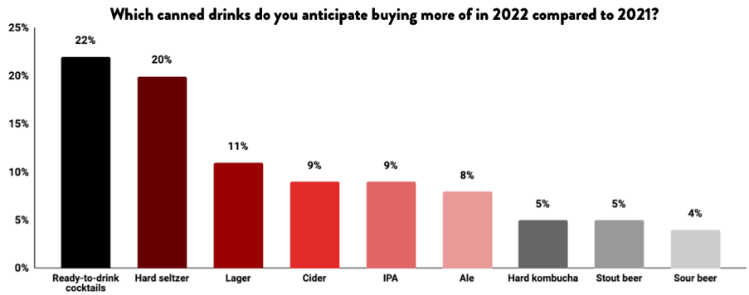
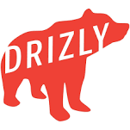

Slide 20
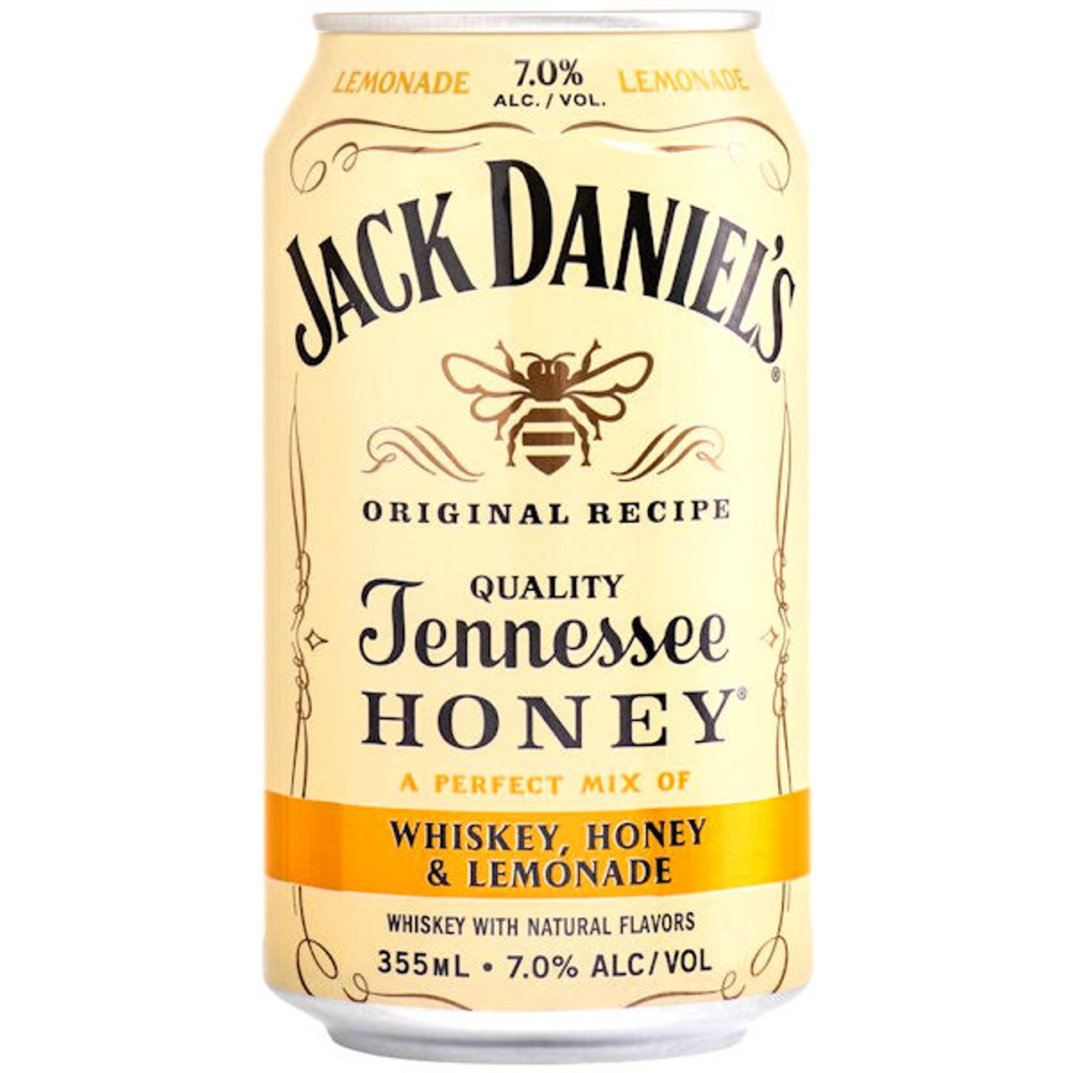

Slide 21
Premium and Super Premium Continue to Flourish Despite Inflation

Slide 22
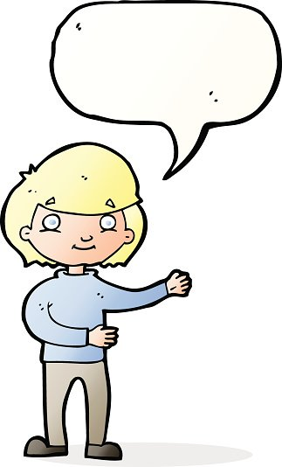
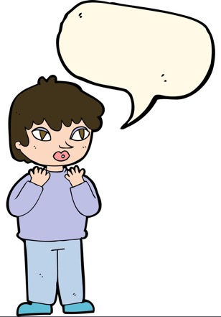
Quality ingredients!
PRICE!
Rarity!

Slide 23
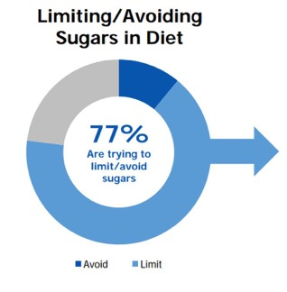
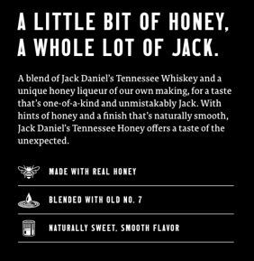
The expanding definition of super premium being driven by “clean” spirits/
Source of ingredients
Processing, or lack thereof of ingredients
Sustainability of ingredients

Slide 24
What’s Next?

Slide 25
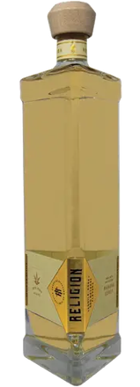
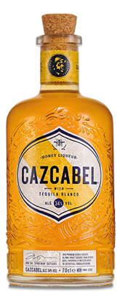
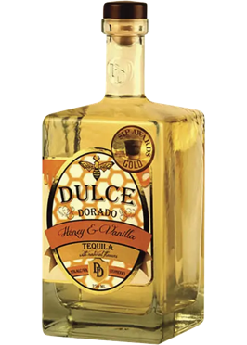
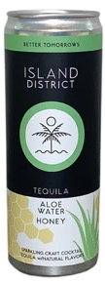

Slide 26
Email questions to keith@honey.com

