Slide 1
Using Pollination Messaging to Entice Food & Beverage Manufacturers

Slide 2
91% of consumers are more likely to buy from a company that supports social or environmental issues.
Spending on cause-related marketing is expected to reach $3.96 billion in 2022

Slide 3
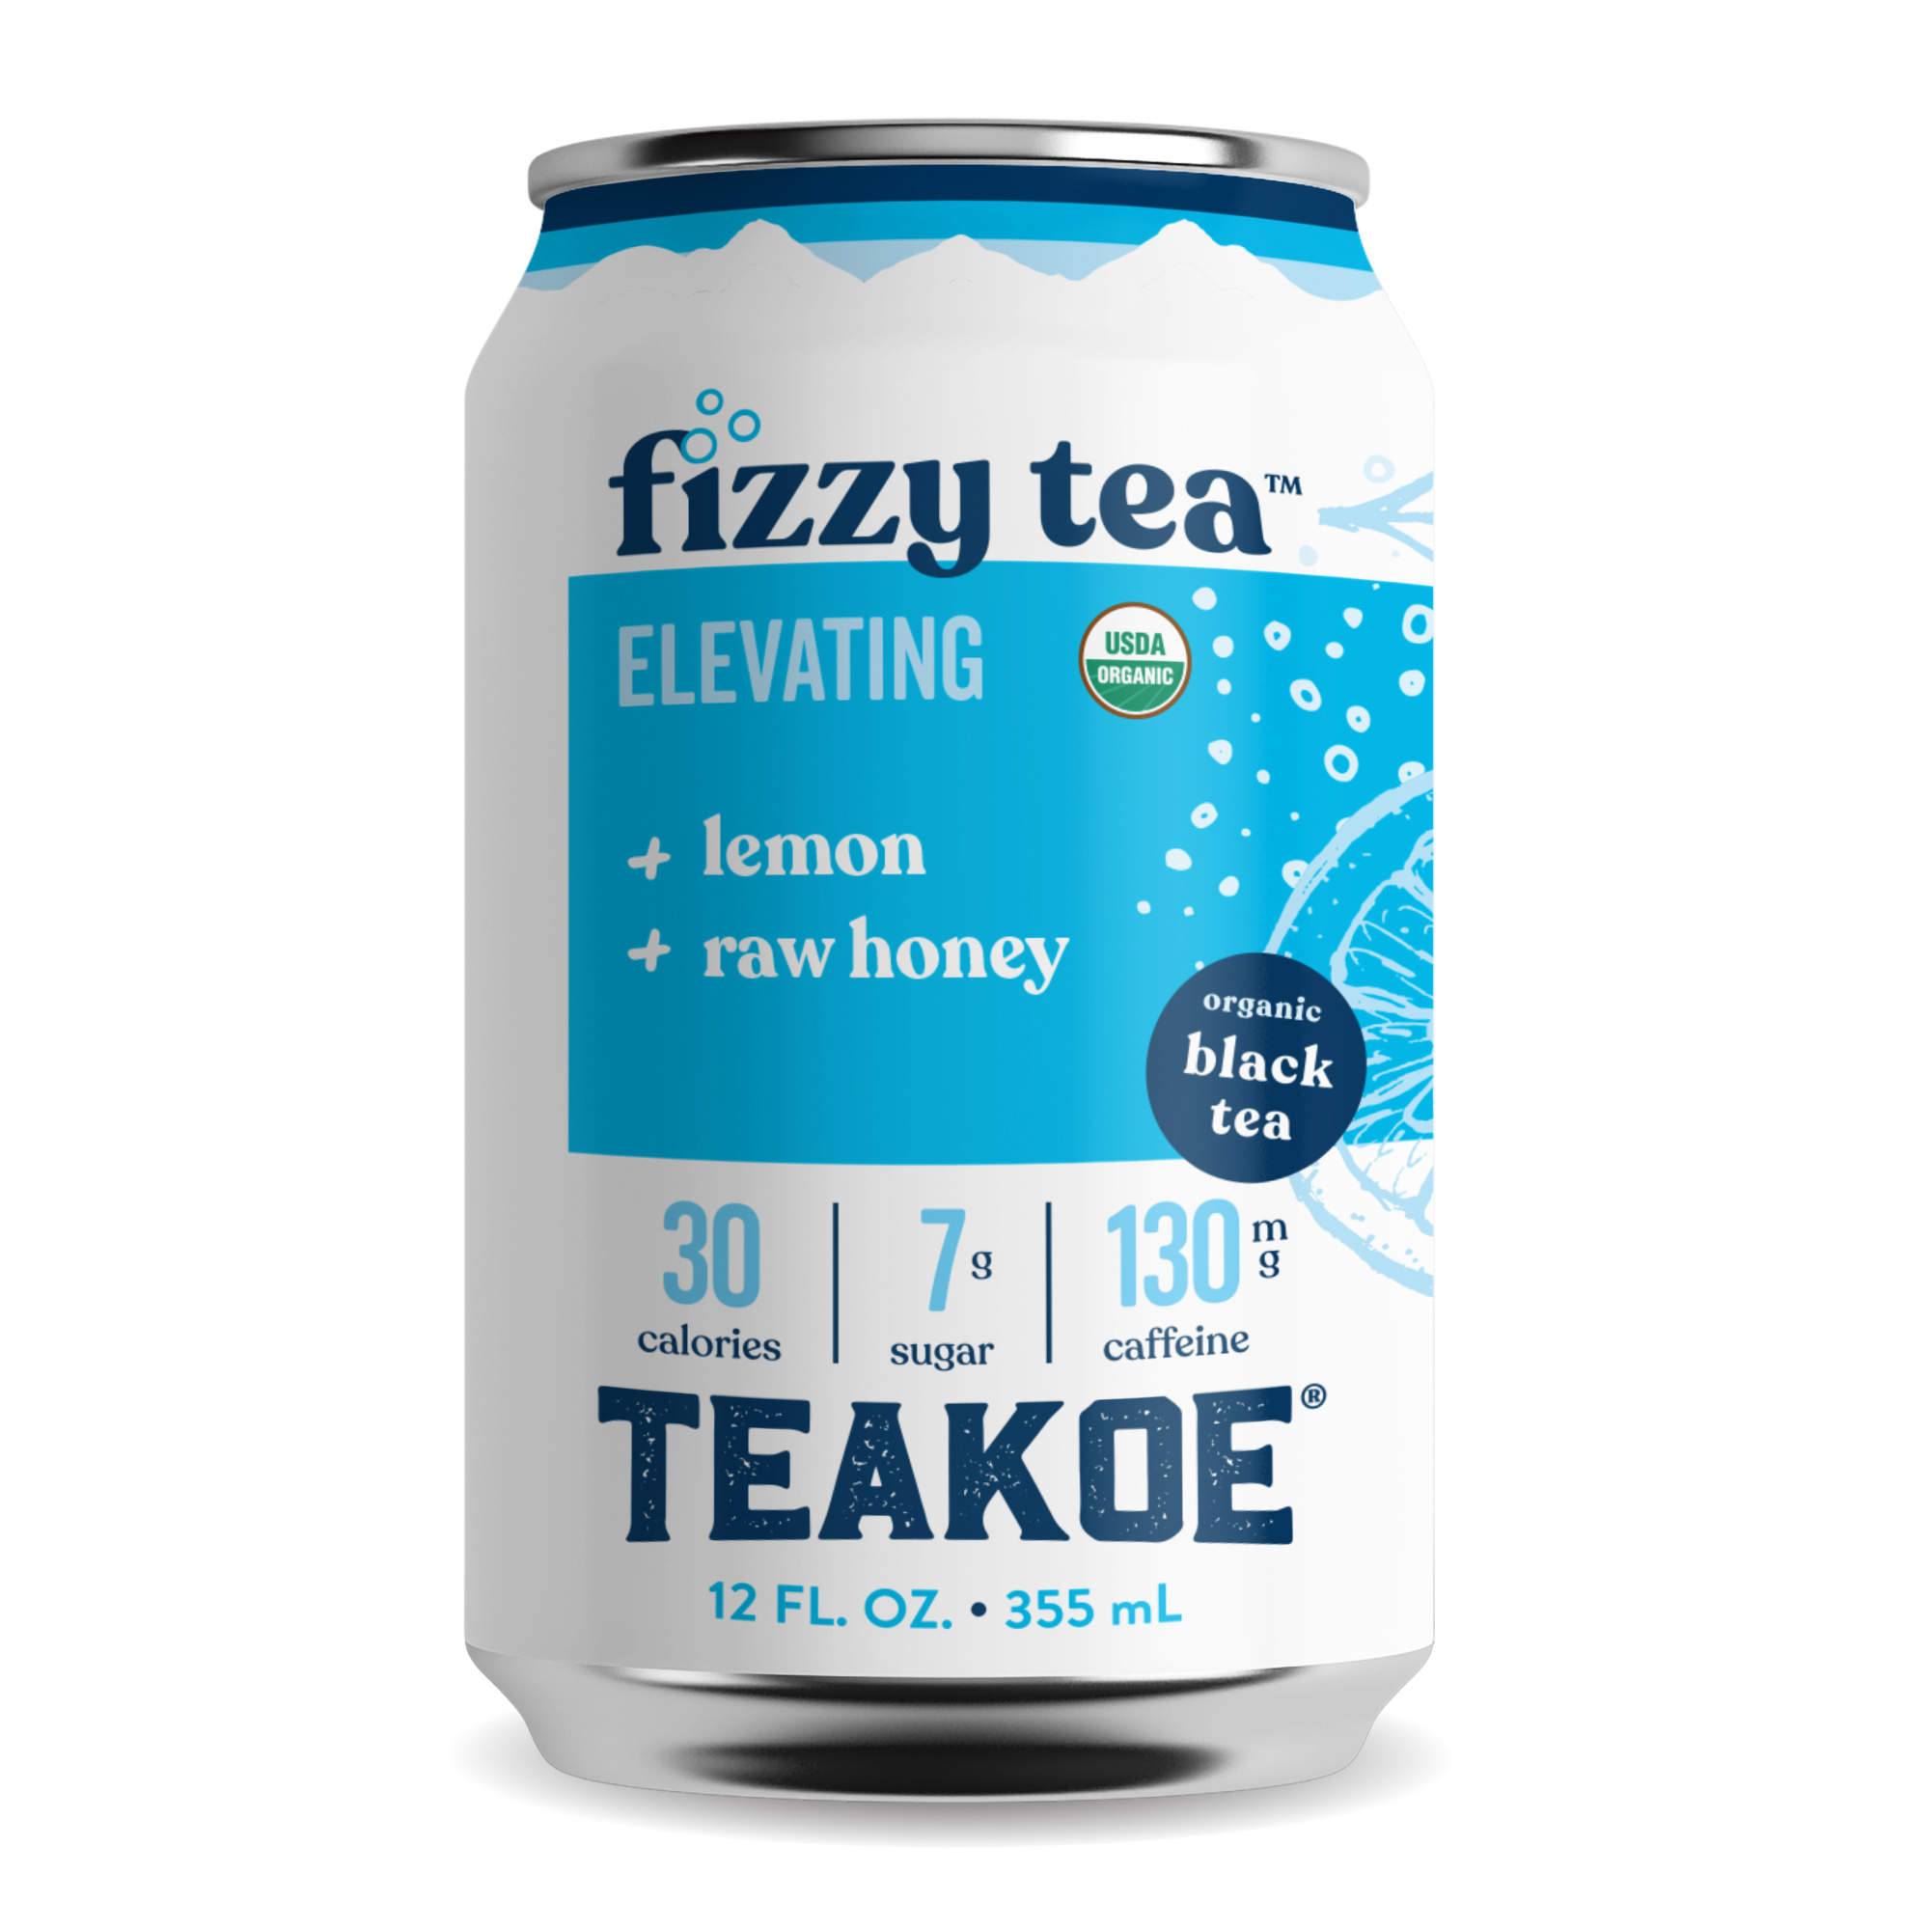
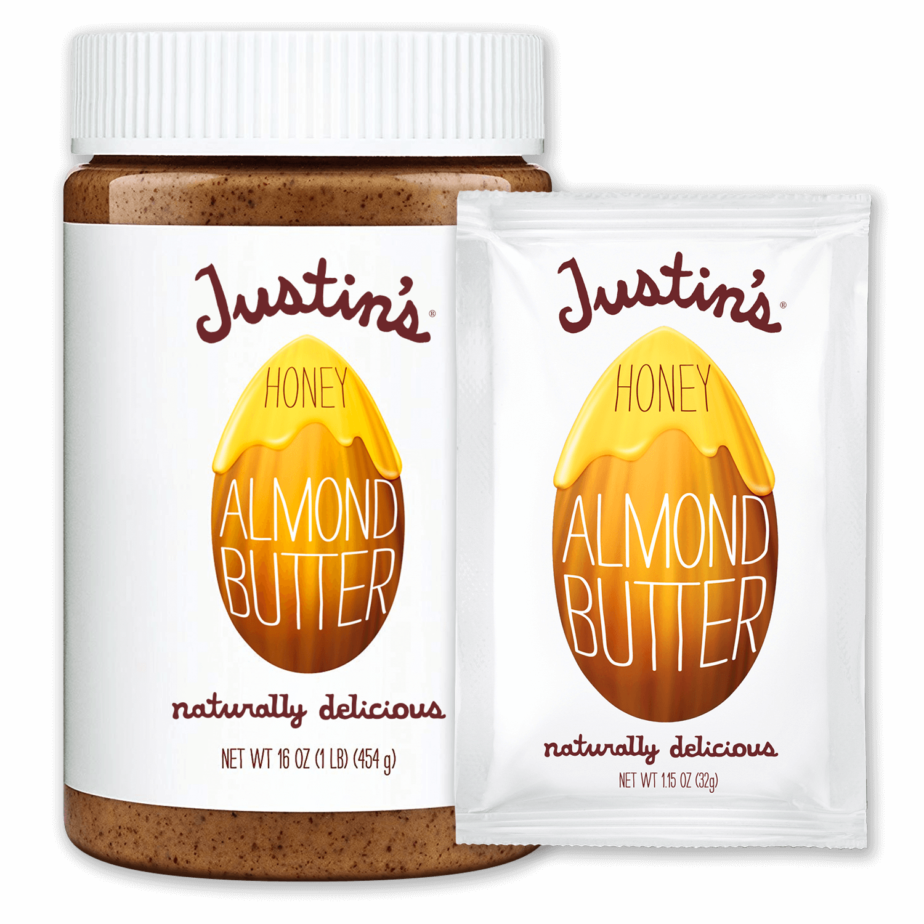
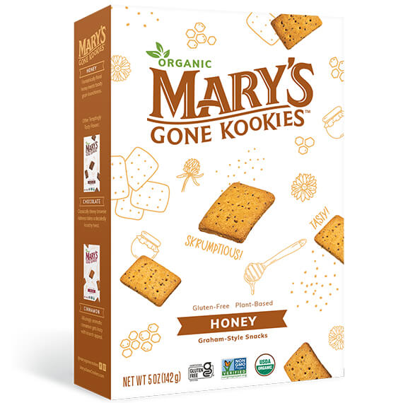

Slide 4
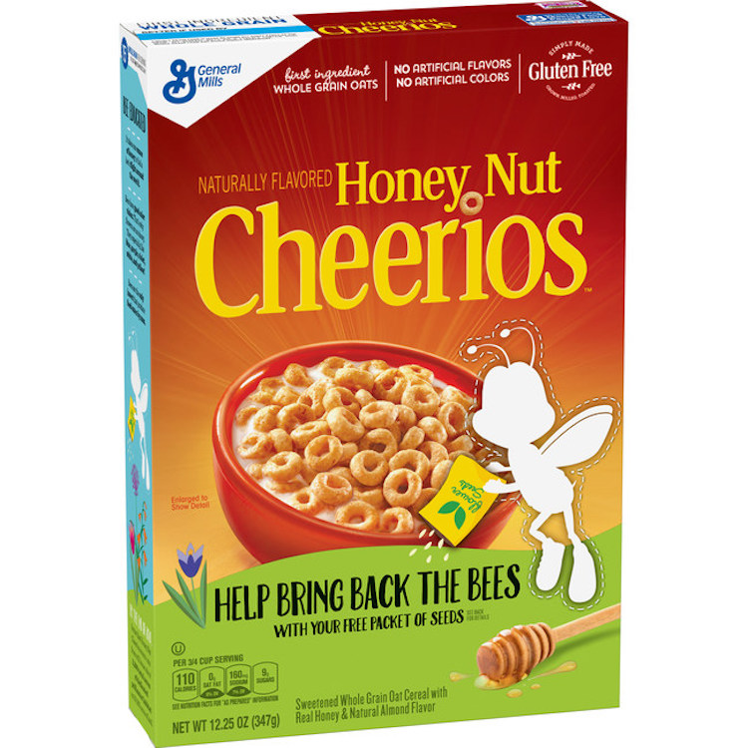

Slide 5
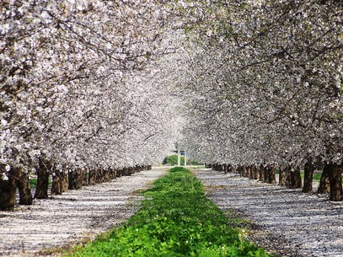
Honey bees and pollination
About 1/3 of the U.S. diet is derived from honey bee pollinated plants. About 35% of the calories we consume comes from honey bee pollinated fruits, nuts and vegetables.
There are 90 different crops that are reliant on beekeepers and honey bees.

Slide 6
Honey bees and pollination
Alfalfa
Allspice
Almonds
Alsike clover
Apples
Avocado
Berseem
Blackberries
Blueberries
Buckwheat
Cacao
Cantaloupe
Carambolo
Casaba
Cardamom
Cashew
Celeriac
Chayote
Cherries
Chinese gooseberry Cicer milkvetch
Cinnamon
Citron
Clovers, minor
Cranberries
Crenshaw
Crimson clover
Crownvetch
Cucumbers
Currants
Cut flower seeds
Dewberry
Drug plants
Eggplants
Garlic
Gooseberries
Herbs (spices)
Honeyball
Honeydew
Huckleberry
Jujube
Kenaf
Kiwi
Kohlrabi
Kola nut
Lavender
Litchi
Longan
Lotus
Macadamia
Mango
Mustard
Nectarines
Niger
Nutmeg
Parsley
Parsnip
Passion fruit
Peaches
Pears
Persimmon
Pimenta
Plums & prunes
Pummelo
Pumpkin & squash
Quinine
Radish
Rape
Raspberries
Red clover
Rutabagas
Sainfoin
Sapote
Sunflower
Sweetclovers
Sweetvetch
Tangelo
Tangerine
Tea
Trefoils
Tung
Turnips
Vegetable seeds
Artichoke
Asparagus
Caraway
Carrots
Celery
Chicory
Chives
Cole crops
Broccoli
Brussels sprouts
Cabbage
Cauliflower
Collards
Kale
Tendergreens
Coriander
Dill
Fennel
Leek
Onion
Persian melon
Vetch (hairy)
Welsh onion
Watermelon
White clove

Slide 7
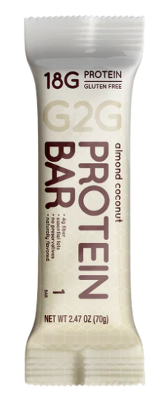
Ingredients: Freshly Ground Almond Butter, Whey Protein Isolate, Honey, Organic Brown Rice Syrup, Certified
Organic Gluten Free Oats, Coconut Flakes, Diced Almonds, Organic Coconut Oil, Organic Flax Seed Meal, Organic Tapioca Flour, Organic Coconut Sugar Crystals, Non-GMO Sunflower Lecithin (An Emulsifier), Sea Salt, Organic Vanilla Extract, Organic Cinnamon.

Slide 8
Email questions to keith@honey.com

